Slide 1
HELMo
Haute Ecole Libre Mosane
Liège – Belgium
International week
19 – 23 February 2024

Slide 2
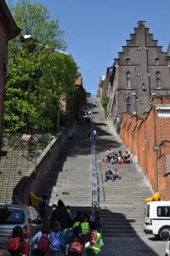
Ready
to climb
the 374 steps
to discover
our
multicultural
city
and society ?

Slide 3
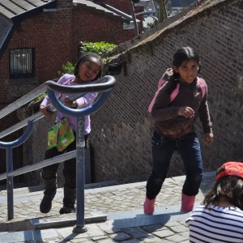
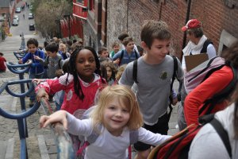
Building intercultural
bridges in the classroom

Slide 4
Provisional program
Arrival in Liège on Sunday
Monday
Ice-breaking activities
Criss-cross discovery of education systems
and of multiculturalism in Europe
Workshop: « Language awareness»

Slide 5
Provisional program
Tuesday
Workshop :
« Intercultural communication»
Guided tour in Liège
Wednesday
Workshops

Slide 6
Provisional program
Thursday
School visit
Cooking workshop : « Meeting migrants »
Friday
Workshop : « Culturally diverse children books/plurilingual literature »
Feedback and conclusions

Slide 7
Feedback from participants
Don‘t judge a person by his/her culture
I re-connected with my initial motivation
to become a teacher (I felt it….)
Always keep on going;
There‘s always something more you can achieve
I learned a lot about myself

Slide 8
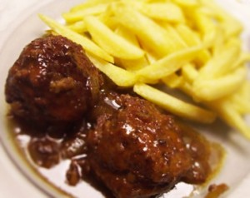

Social event organized by
HELMo students
Traditional dinner
offered by HELMo

Slide 9
Cost
Travel and personal expenses
Accommodation :
- in Belgian families (free if reciprocity,
otherwise 80 € half board)
- in a student’s room with possibility
to cook (20 € / night without meals)
- at the youth hostel (from 23 € / night
in shared rooms with breakfast only)

Slide 10
Practical tips
Languages: English and French
English is required, French is an asset but not compulsory
ECTS: 1
Certificate of attendance
Arrival on Sunday
Departure Friday night or Saturday morning
Nomination deadline: November 20th

Slide 11

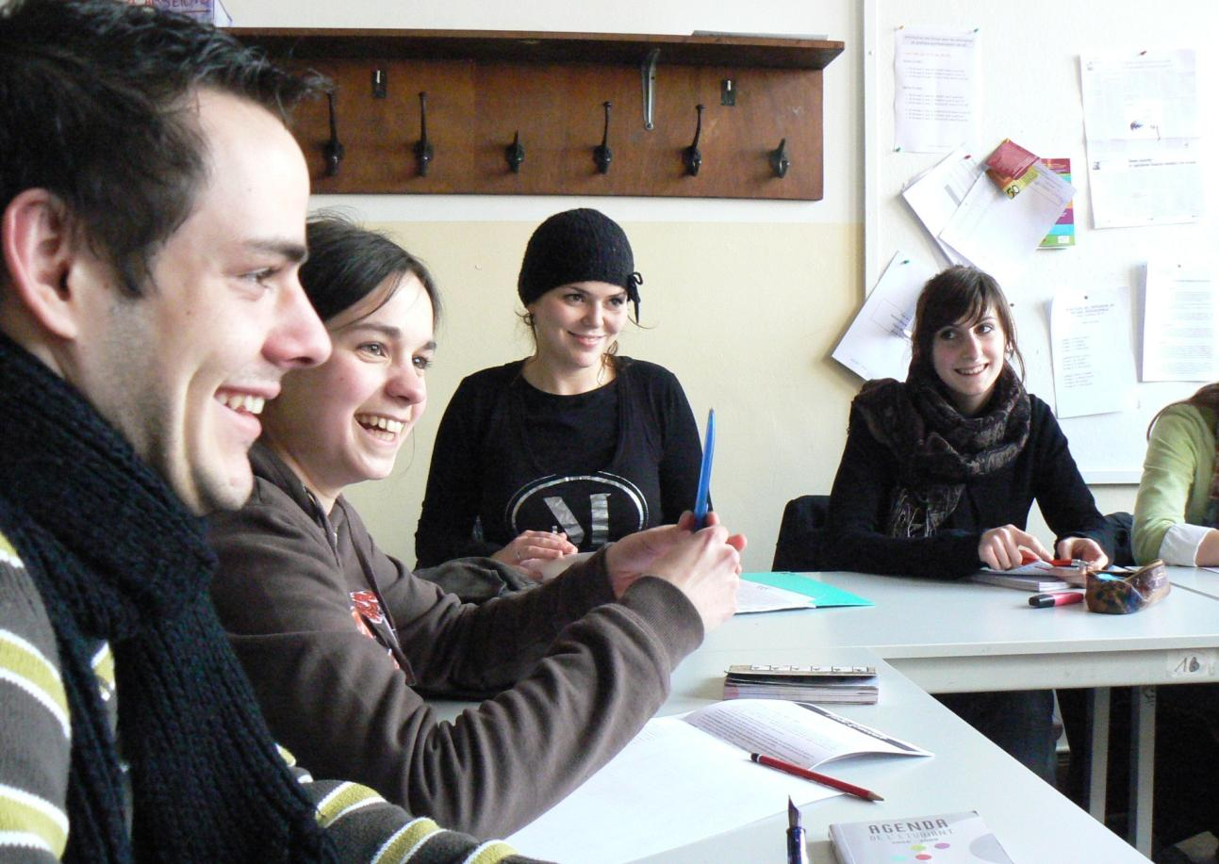

https://learn-pedagogique.helmo.be/course/view.php?id=3820

